Slide 1
Tutorial on Huawei Cloud SG Healthcare AI Datathon 2021
Lan Xiang (ephlanx@nus.edu.sg; whatsapp 97740278)
Mornin’s Lab
Saw Swee Hock School of Public Health
National University of Singapore

Slide 2
Components
Elastic Cloud Server (ECS)
Remote CPU/GPU Server
For teams using EHR data:
Relational Database Service (RDS)
EHR Databases
For teams using image/video data:
Object Storage Service (OBS)
Downloading Imaging Datasets to your ECS

Slide 3
Elastic Cloud Server (ECS)
Access via SSH
ssh root@serverip
Username: root
Password of your team’s ECS will be given to team coordinator
! Do not share your server ip and password outside your team

Slide 4
Elastic Cloud Server (ECS)
Activate Default virtual environment: conda activate tf1
Installed packages:
Anaconda packages, PyTorch 1.7.1, TensorFlow 2.0.0
Feel free to install more packages that you need
To use Jupyter Lab (Python and R), do the following:
Step 1: On the ECS terminal:
Just one of the team members do:
run “tmux”, enter tmux session
conda activate tf1
run “jupyter lab --no-browser --allow-root”, start jupyter lab server
Copy the token and save it somewhere for later use
press ctrl+b, then press d, back to main screen
Step2: On your own laptop’s terminal
run “ssh –f –L 8888:localhost:8888 root@serverip –N” and input the ECS password
Change to 8123:localhost:8888 to use local 8123 port if your local computer has port 8888 occupied
Go to your browser, type url “localhost:8888/lab/workspaces/<ID>”, enter
ID should be unique for each user in your team, you can set your own ID
e.g. localhost:8888/lab/workspaces/batman, localhost:8888/lab/workspaces/spiderman

Slide 5
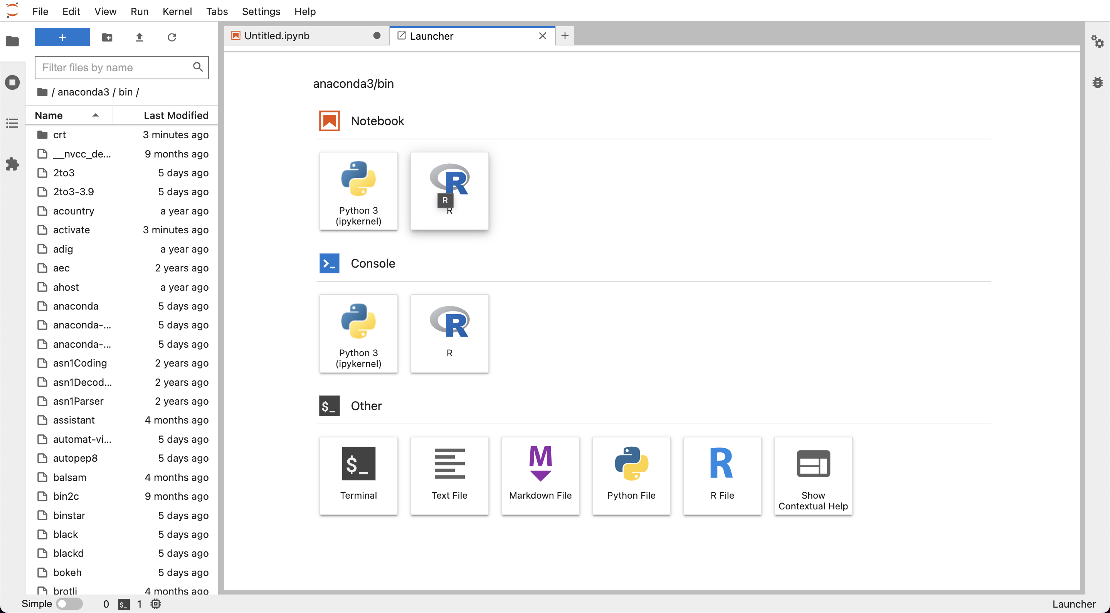
Remote Jupyter Lab
After following the previous steps, we can now have this page at website.

Slide 6
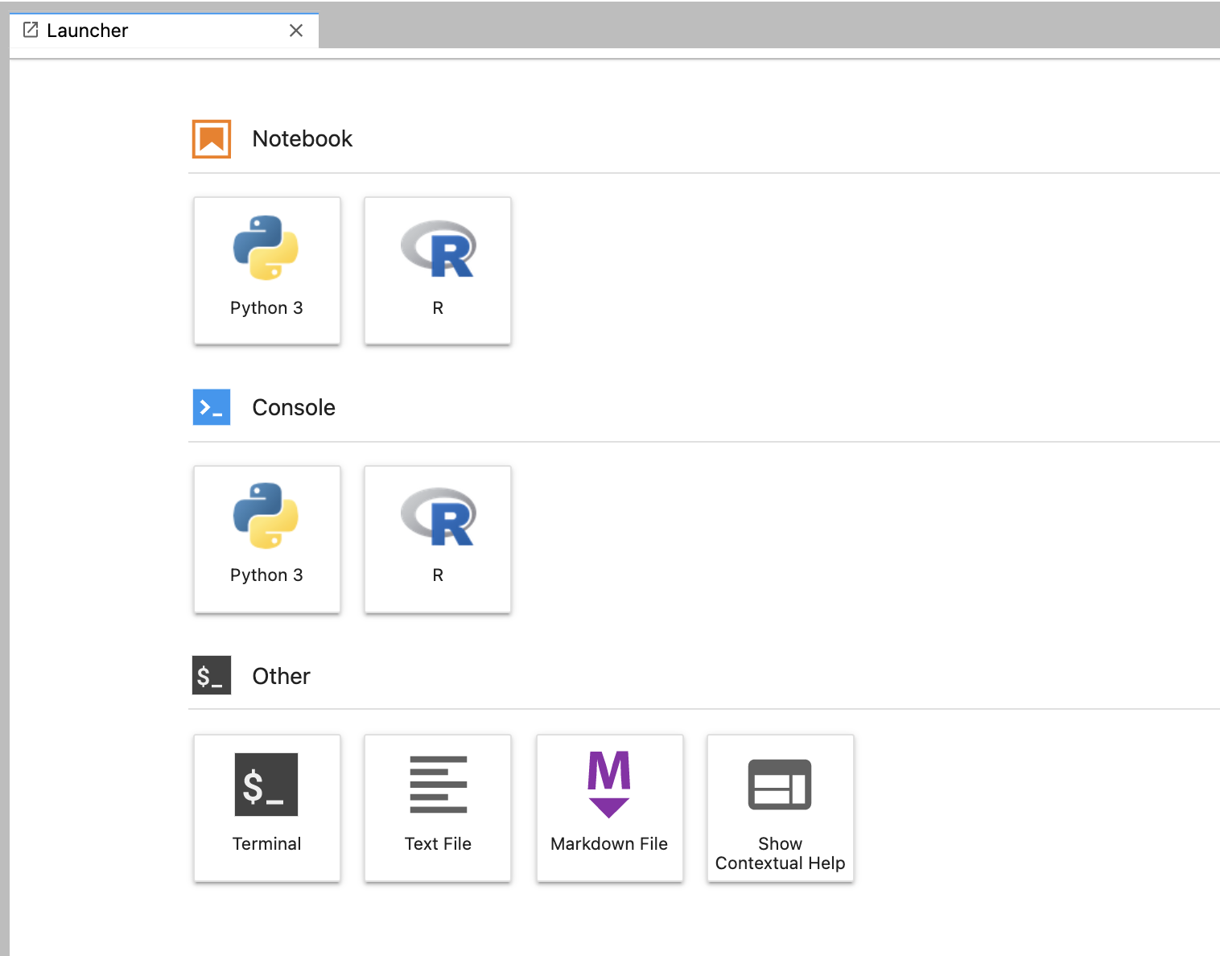

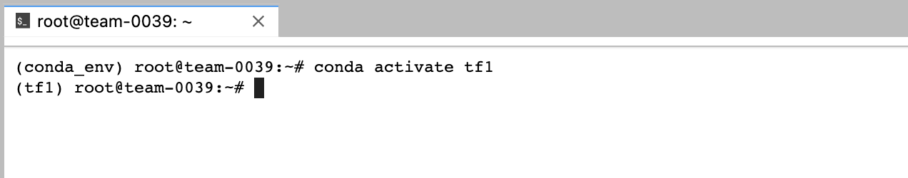
Remote Jupyter Lab function
Choose the program language
Create new launcher
Upload file
Create new folder

Slide 7
To login into RDS
RDS Host ip address: 192.168.0.168
Username: team name (e.g., team01, …, team15)
Password of your team’s RDS will be given to team coordinators
Register your relational database:
Step1: click Servers
Step2: click register → server
Step3: General → name (fill your team name, e.g., team01)
Step4: on next page

Slide 8
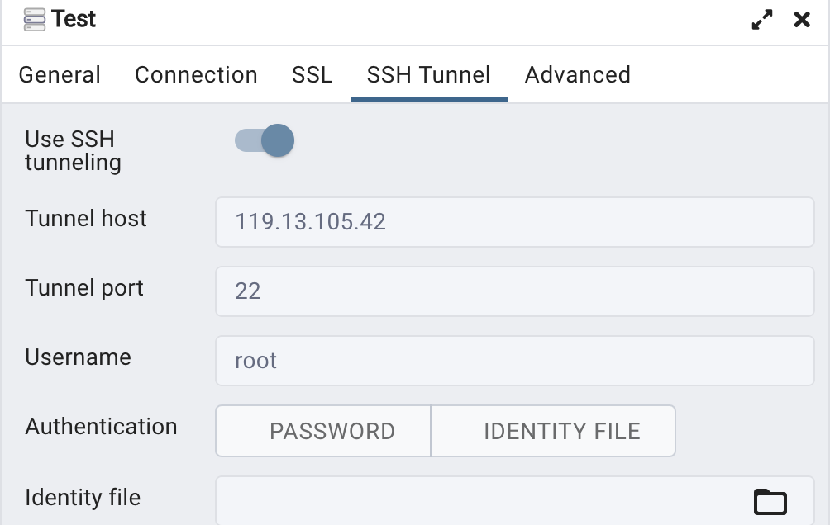
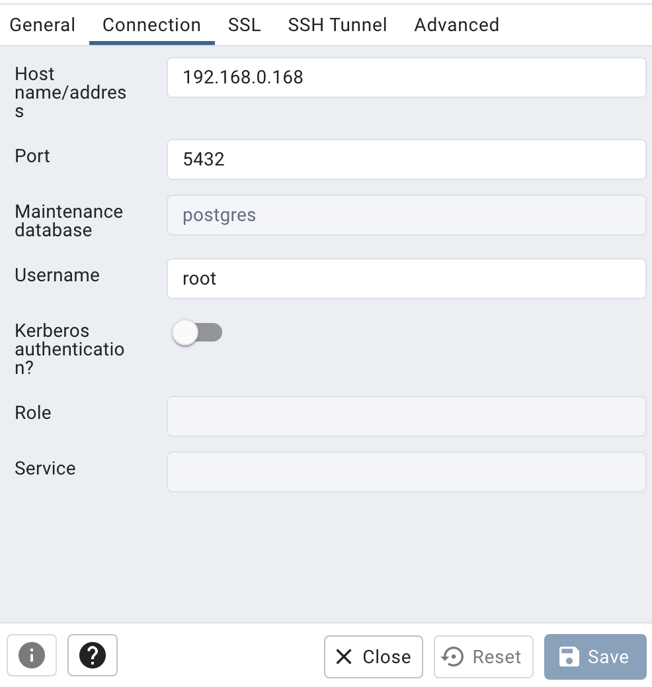
Use pgAdmin to connect RDS
Your own server ip
Username: root
Password: server password
Username: team name
Password: rds password

Slide 9
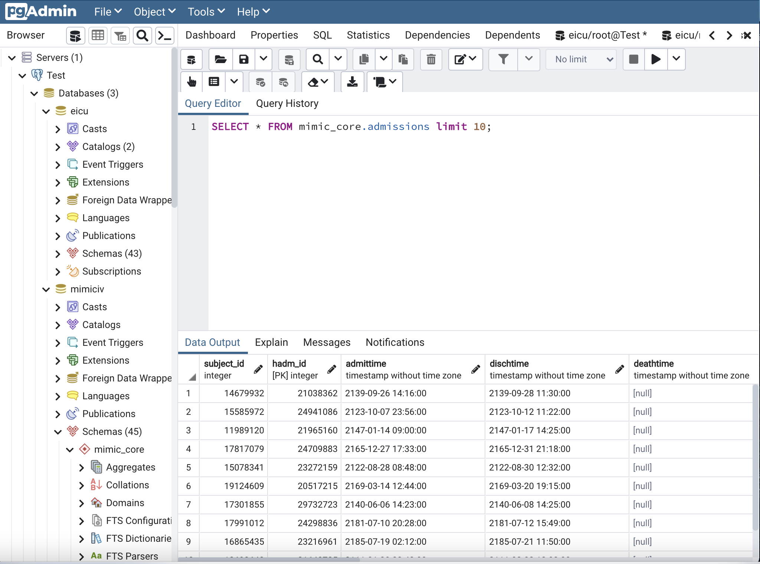
Write SQL

Slide 10
Export results to local CSV
Download the result

Slide 11
Object Storage Service (OBS)
For teams who need using image/video dataset, team coordinator please contact me (whatsapp 97740278) to download dataset to your server.

Slide 12
Q&A
If you have any questions, please feel free to contact me (ephlanx@nus.edu.sg)
Whatsapp: 97740278

